Slide 1
Final Project - Haptics
Vitrector Insertion Simulator/Orbital Region
Rogerio Nespolo

Slide 2
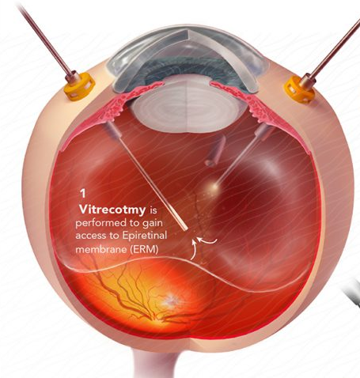
Vitrectomy
Eye surgery to treat various problems with the retina and vitreous. During the procedure, the vitreous is removed and replaced with another solution.

Slide 3
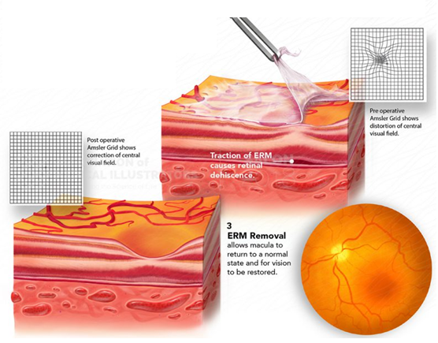
Membrane peel
The Vitrectomy with epiretinal membrane peel is the most common vitreoretinal surgery - an epiretinal membrane is a condition where a very thin layer of scar tissue forms on the surface of the retina. This membrane must be peeled to recover the distorted/blurred vision.

Slide 4
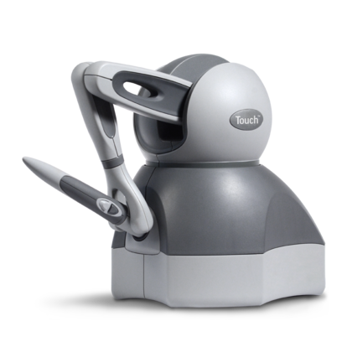
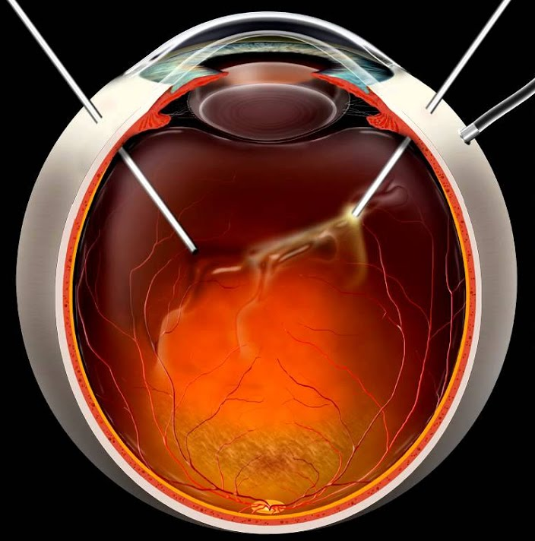
Goals
Create an environment where medical students can learn the best practices for the incision of a vitrector into the vitreous chamber
Provide guidance about the best approach and the most common problems the surgeon can face, using textual, haptic and audio feedback

Slide 5
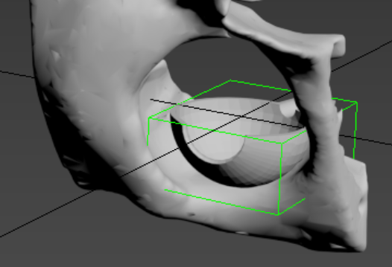
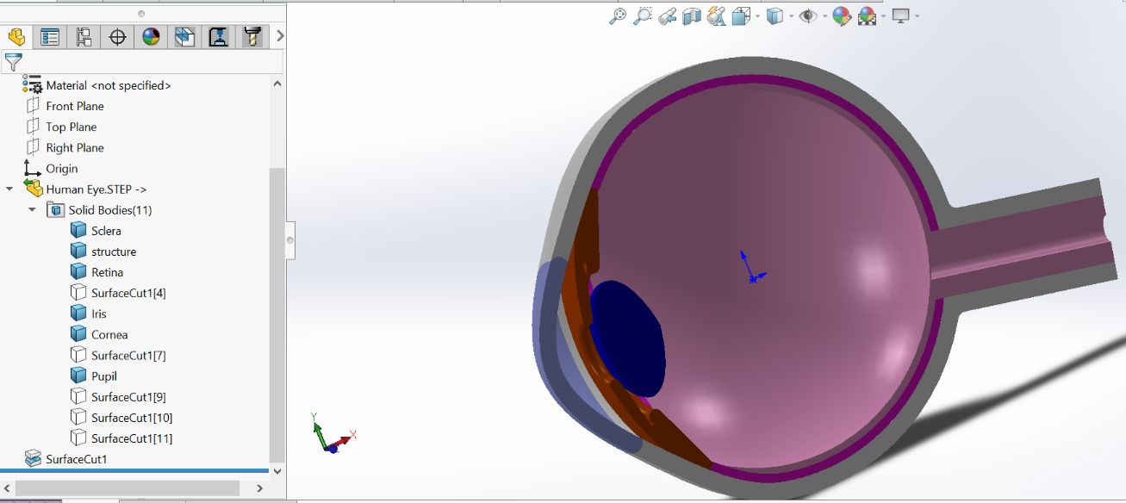
Models
Eye model acquired from a 3D database
Lateral cut and segmentation of each element of the eye - SOLIDWORKS
Textures and alignment of the models - Autodesk 3DS Max

Slide 6
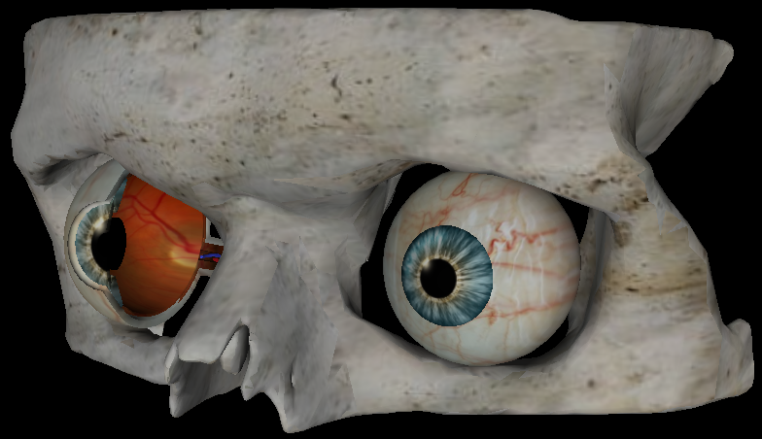

Slide 7
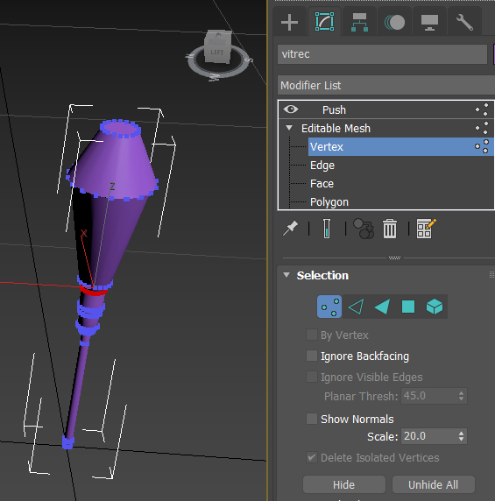
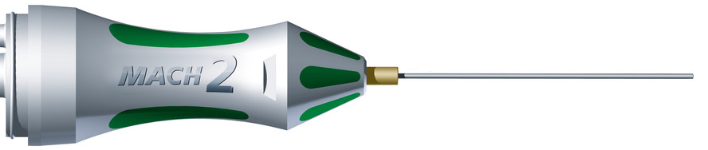
Cursor
Created from Scratch with Autodesk 3DS Max
Mesh and Poly editor tools
following a model of a commercial-available vitrector

Slide 8
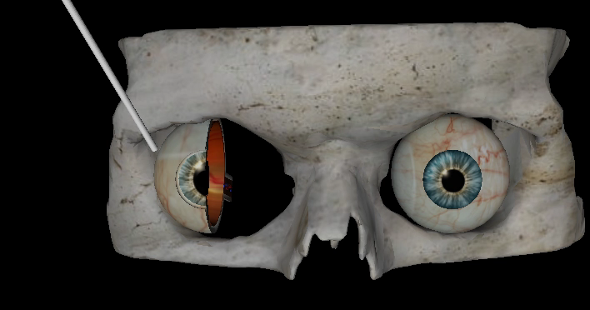
Effects
Eye rotation
Force acquired during graphics callback
setRotationInPlace with the direction and magnitude of the force in real-time
The movement is limited to imitate the real behavior of the eye

Slide 9
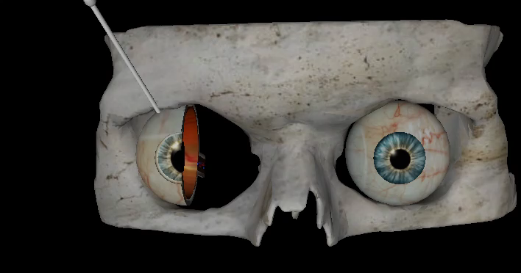
Effects
Fulcrum effect within the vitreous chamber

Slide 10
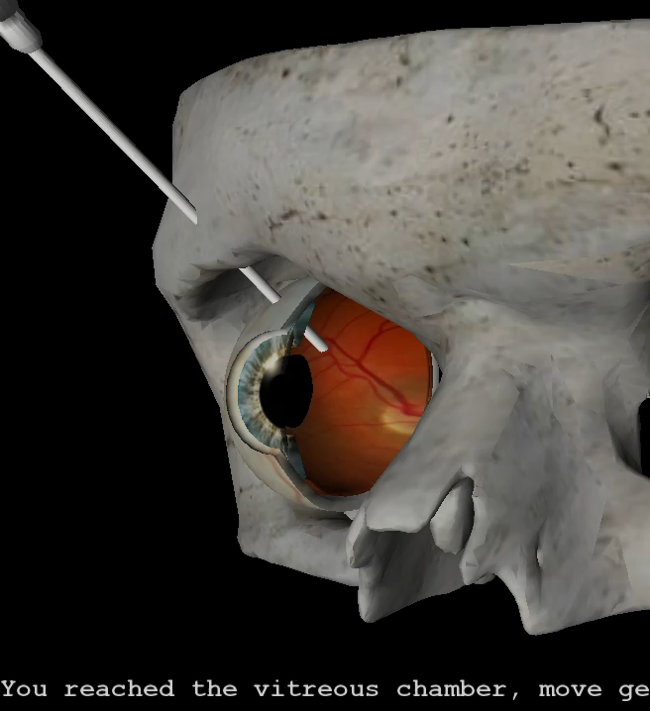
Effects
Vibration and warning when collision with the retina is detected

Slide 11
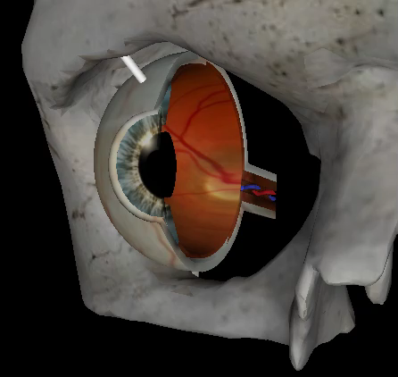
Effects
Vitrector volume increases according to the distance to the retina/optical nerves
3D sound follows the position of the model inside the scene

Slide 12
Warnings
Warnings are presented during the execution – an example of how the vitrector must be guided is exhibited
Touching the iris or pupil prior the insertion
Applying too much force when the membrane peeling is being executed
After the insertion of the tooltip into the vitreous chamber

Slide 13
Limitations
Pop through effect value of the sclera is relatively small to deactivate properly the fulcrum effect automatically
The user can reset all the effects releasing the button 2 - this avoids the program to keep applying the effects even after the tool removal

Slide 14
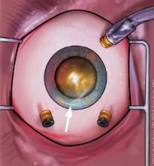
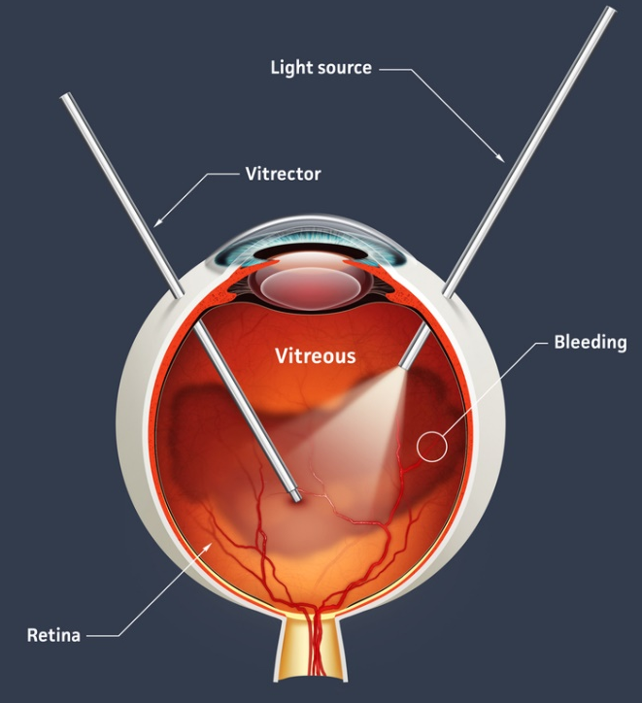
Future developments
The use of a second haptic device for the simulation of the fiberoptic endoillumination (light source)
The possibility of changing the cursor to simulate all the vitrectomy tools available during the real procedure
Simulate the procedure of inserting multiple cannulas

Slide 15
Thank you!
Please execute in Debug Mode, x64 – Be sure that the Windows SDK version is correctly selected and OpenAL is properly installed

